Slide 1


Resume Parsing System
This project introduces a system designed to simplify resume processing. The system automates key tasks such as resume upload, text extraction, NER, streamlining the process and saving time.
Notes:
1

Slide 2

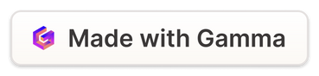
Key Features of the System
1
Automated Resume Parsing
2
Intelligent Filtering
Filter candidates based on specific criteria, such as keywords, experience level.
Effortlessly extract key information from uploaded resumes, including contact details, skills, and experience.
3
Customizable Shortlisting
4
Detailed Analytics
Gain valuable insights into candidate trends and identify potential patterns.
Create personalized shortlists based on your specific needs and preferences.
Notes:
2

Slide 3
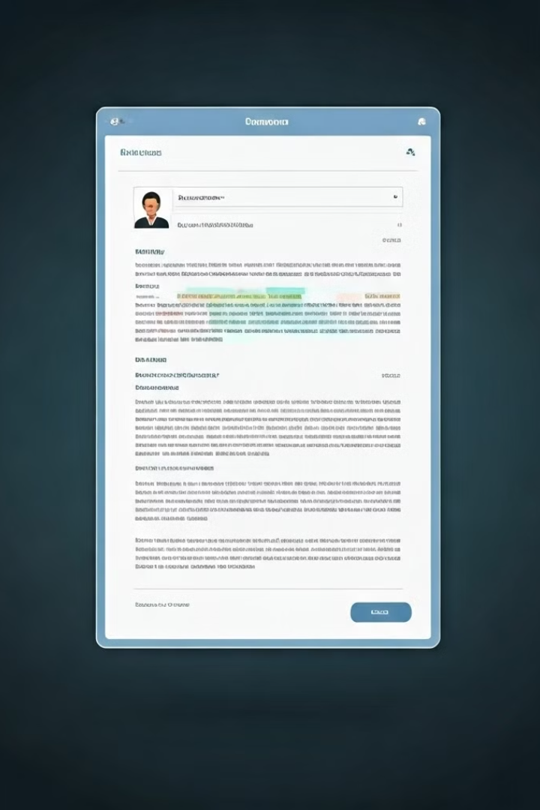




Resume Upload and Text Extraction
Resume Upload
Users can upload resumes directly through the user interface or by using an API call.
File Validation
The system checks the validity of the uploaded file, ensuring it is in a supported format (PDF, DOC, DOCX).
Text Extraction
The system uses OCR (Optical Character Recognition) to convert the uploaded file into text.
Entity Recognition
The system uses NER (Name Entity Recognition) to extract useful entities from the CV.
Notes:
3

Slide 4
File Handling and Logging
Secure Storage
Auditing
Monitoring
Resumes are stored securely in our MongoDb database, protecting confidential data.
Detailed logs track all actions performed, including uploads, downloads, and edits.
Logs are regularly monitored to identify potential issues or patterns, helping to improve the system.
Notes:
4

Slide 5
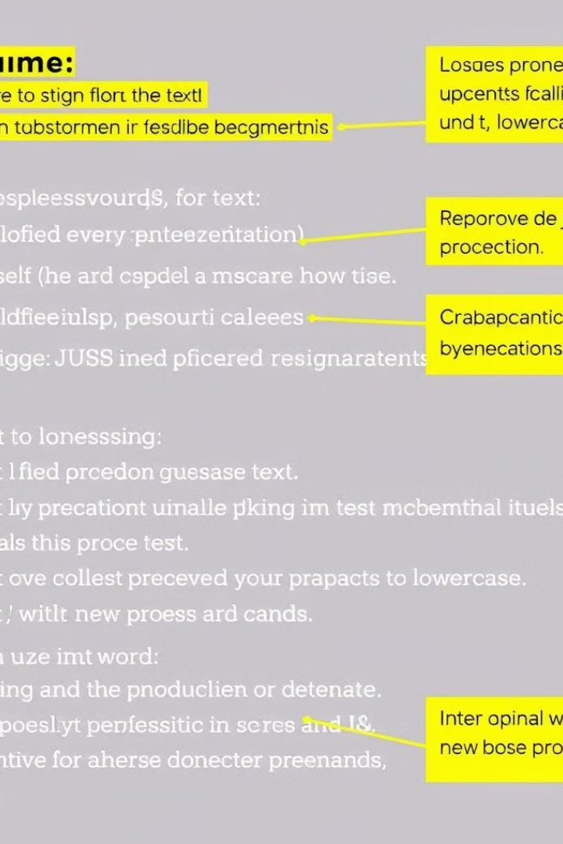
Text Preprocessing
Tokenization
Stemming
Break down the text into individual words or units.
Reduce words to their base form, removing suffixes and prefixes.
Stop Word Removal
Normalization
Eliminate common words that do not contribute to meaning.
Standardize text by converting all characters to lowercase and removing punctuation.
Notes:
5

Slide 6

Workflow and Integrations
1
OCR
Convert various format resumes like .doc, .docx, .pdf to machine-readable text.
2
Text Preprocessing
Clean and format resume text for efficient analysis.
3
NER
Identify and extract key entities, such as names, skills, and companies.
4
Filtering
Apply filters to narrow down the list of candidates based on your criteria.
5
Shortlist
Create a shortlist of the most qualified candidates.
Notes:
6

Slide 7

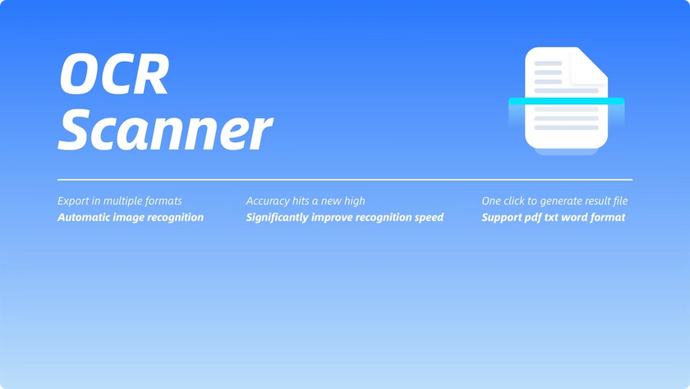
Optical Character Recognition (OCR)
OCR Technique
Description
Tesseract
Open-source OCR engine with high accuracy and multilingual support.
Google Cloud Vision API
Cloud-based OCR service with advanced features for document analysis.
Notes:
7

Slide 8





Named Entity Recognition (NER)
Person
Skill
Identify names of individuals, including candidates and employers.
Extract technical and soft skills listed in the resume.
Reference Links
Experience
Recognize urls, work links and social media links mentioned in the resume.
Identify the names of companies and organizations where the candidate has worked.
Notes:
8

Slide 9

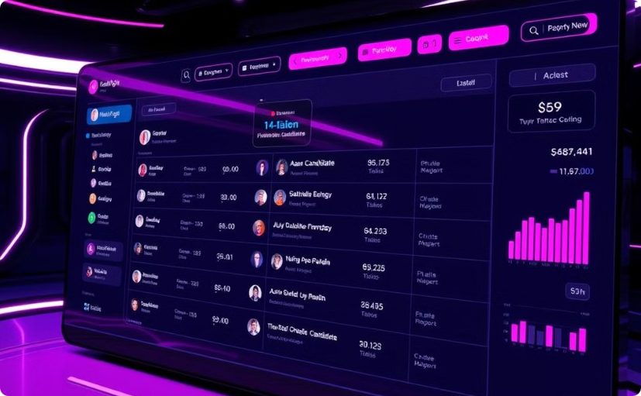
Candidate Filtering and Shortlisting
Keyword Search
Shortlist
Search for candidates with specific skills or experience.
Shortlist's candidates based on best match score according to requisites.
Notes:
9

Slide 10

Conclusion
This project outlines the key features and functionalities of a resume parsing system designed for efficiency and scalability. The system leverages modern technology like OCR and NER to streamline resume parsing and provide valuable insights.
Notes:
10

